Slide 1
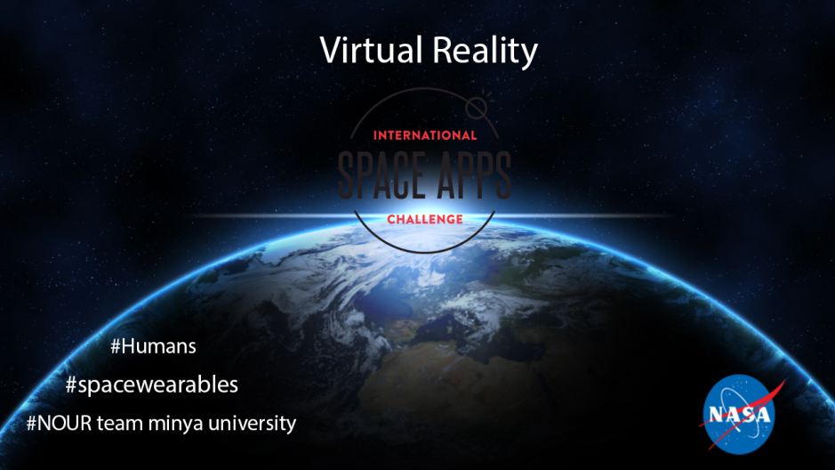

Slide 2
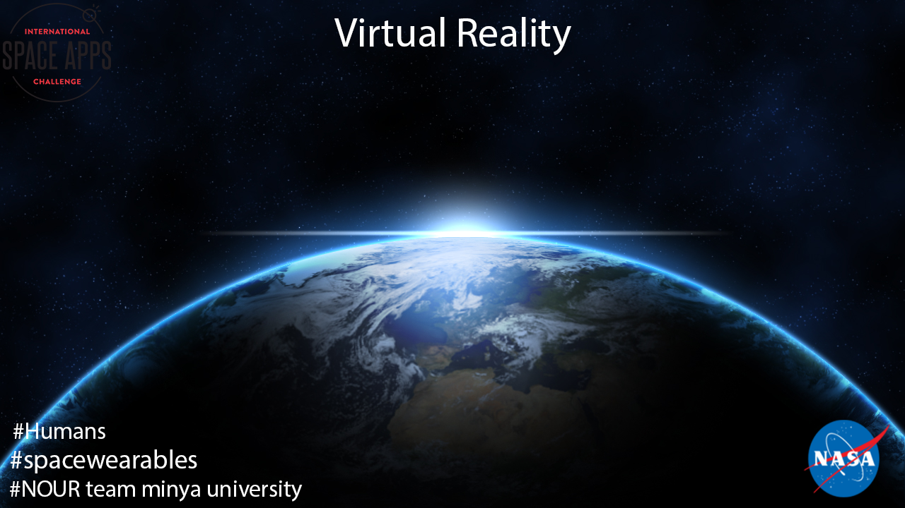
Project virtual reality to give astronauts 3d vision and ability to simulate his movement in some places that could be dangerous or inaccessible by human

Slide 3

Description
The project will use 3d camera been mounting on robot or on suit it will give 360 FOV and it will give you ability to measure distance, and outside it, he can control robot to simulate his movement especially danger situation (e.g. fix parts outside the station, use in labs to manipulate danger material )

Slide 4
Task
1-control 3D camera and dedicating the head movement with android gyroscope.

Slide 5
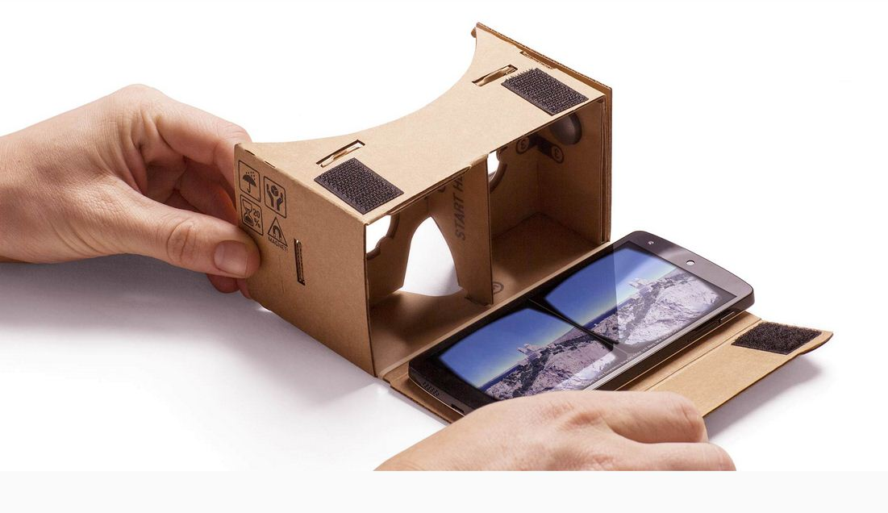
2.The google card board been used for 3d vision .

Slide 6
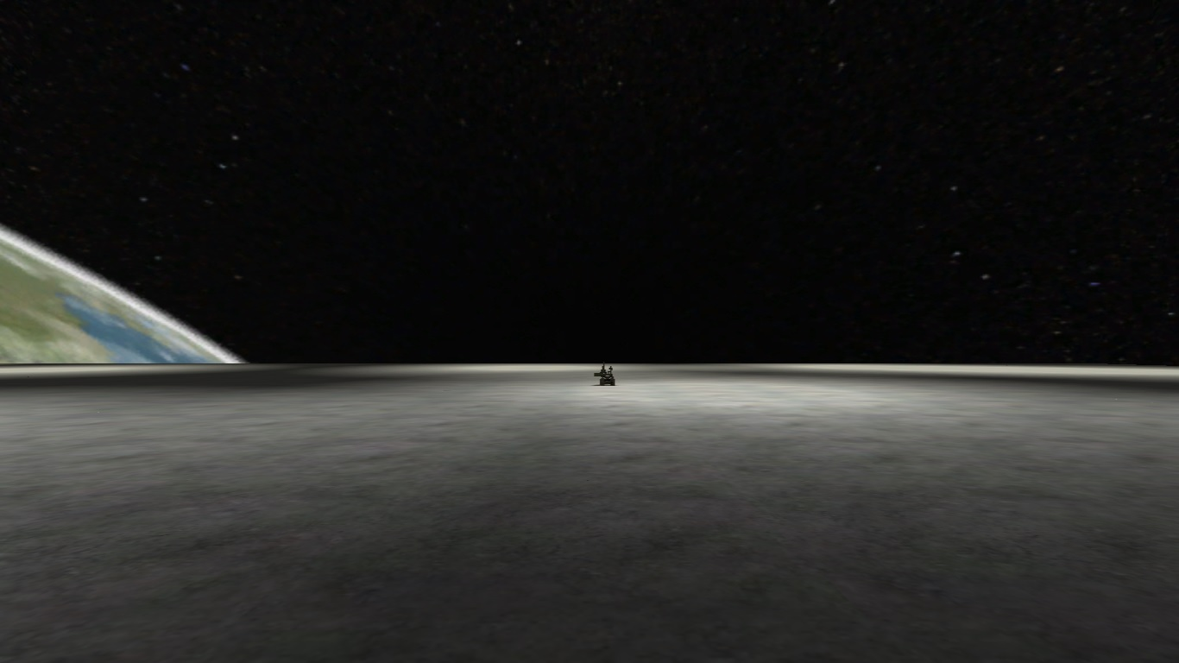
We build a game that simulate the moon environment and the control of the robot on the moon surface.

Slide 7
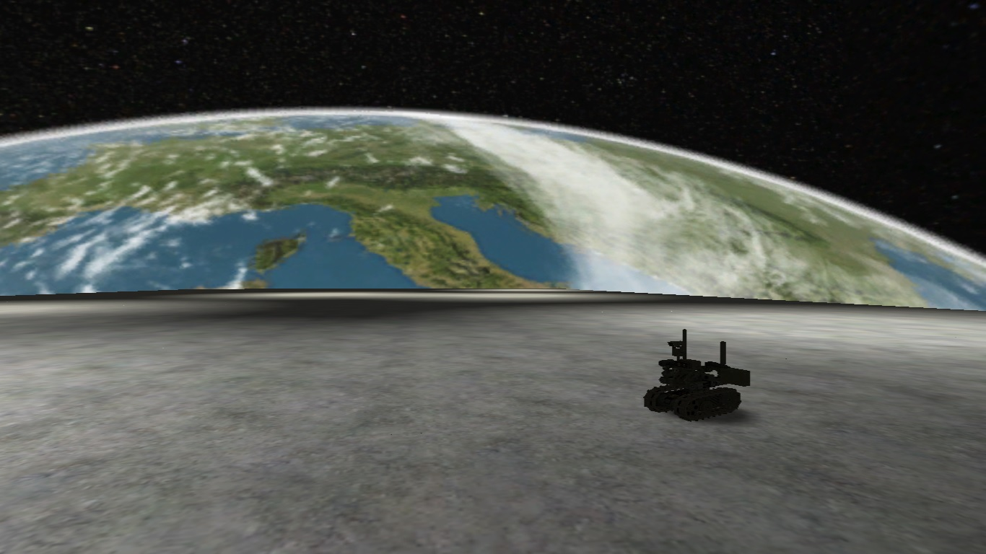
Robot has 3d camera on the top of it on 3 DOF link that give it the ability to have 360 FOV and this link controlled by android sensors in the 3d google card while it stream the 3d camera via it screen to the astronauts , 3d camera provide distance that will make difference with controlling the robot on the normal screen you can handle objects with high Accuracy.

Slide 8
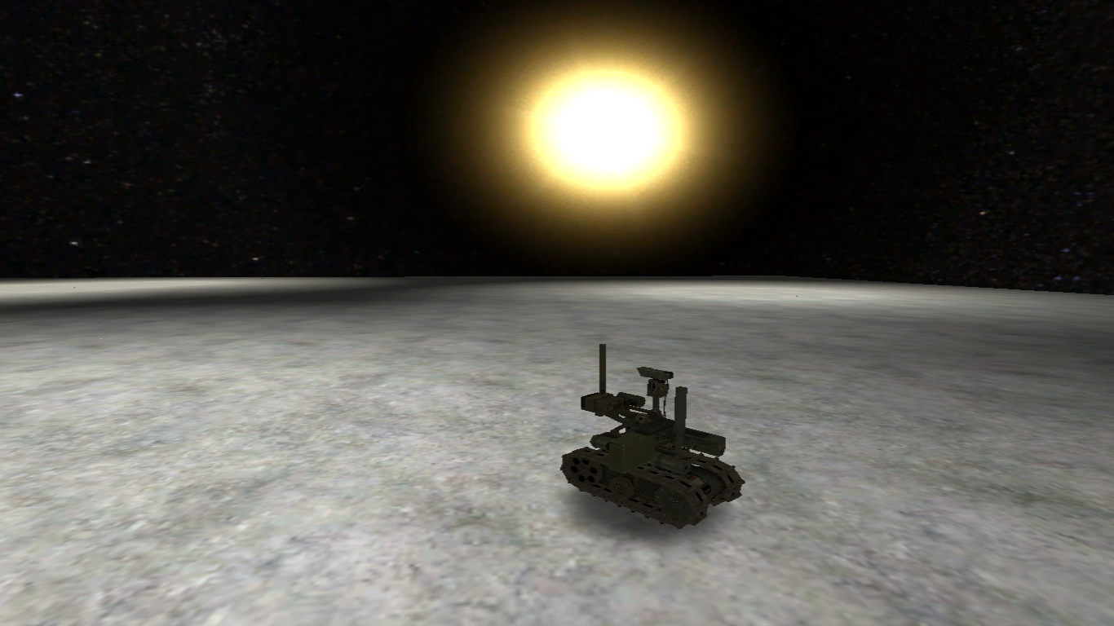
The Augmented Reality is by nature the next generation of interactive environment by all means.

